Slide 1
Hybrid Cryptosystem using RSA 2048 and AES 128 for secure data transfer
STEPin Mini Project
Aditya Saggar

Slide 2
Project Outcomes
Securely transfer files from one client to any other over TCP sockets.
Use Symmetric Encryption to encrypt large files
Exchange AES's shared Keys with another client securely using asymmetric keys

Slide 3
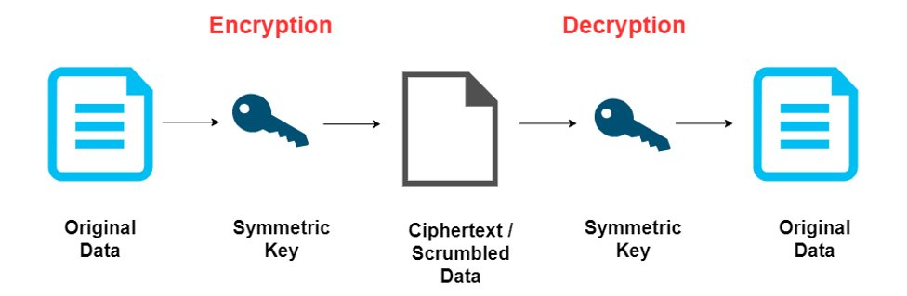
Symmetric Cryptography

Slide 4
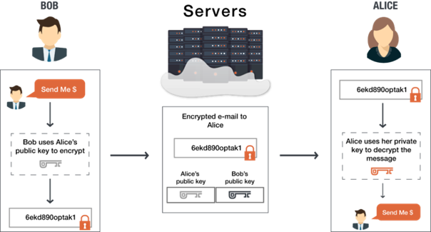
Asymmetric Cryptography

Slide 5
High Level Requirements
Client to Client Connection
File transfer from client to client
Use of TCP Sockets for data exchange
Use RSA (2048 bit) for asymmetric encryption
Use AES (128 bit) for symmetric encryption
Share AES keys securely using RSA at the start of connection

Slide 6
STEPin Concepts Covered
Creating a socket connection to transmit multiple data types
Extensive use of structures
File handling for read/write
Pointer usage & typecasting
Usage of external Libraries
Threading for large prime generation

Slide 7
Challenges
Typecasting from uint8_t to char/string
Conversion from mpz_t to uint8_t
Dynamic Size of files and encryption parameters and effectively sending sizes of values being pointed to
Sending RSA keys through socket without errors
Integration of different levels of encryption

Slide 8
Future Work
Debugging RSA key send functionality
Incorporating Central Server into system for distribution of RSA keys
Server which can handle multiple clients and display available clients for file transfer
Ability for bidirectional transfer
Transfer of multimedia files
Transfer of user text written into terminal (secure chat)
The project can be developed much further to incorporate a large number of features based of the fundamental platform of secure data transfer. Possible Avenues are:

Slide 9
Github Repository
https://github.com/average1129/STEPin-Mini-Project-

